Slide 1
Introduction to HDFS
Notes:
Introduce myself: 8 years data engineering, data analytics (make sense)

Slide 2
What’s HDFS
HDFS is a distributed file system that is fault tolerant, scalable and extremely easy to expand.
HDFS is the primary distributed storage for Hadoop applications.
HDFS provides interfaces for applications to move themselves closer to data.
HDFS is designed to ‘just work’, however a working knowledge helps in diagnostics and improvements.

Slide 3
Components of HDFS
There are two (and a half) types of machines in a HDFS cluster
NameNode :– is the heart of an HDFS filesystem, it maintains and manages the file system metadata. E.g; what blocks make up a file, and on which datanodes those blocks are stored.
DataNode :- where HDFS stores the actual data, there are usually quite a few of these.

Slide 4
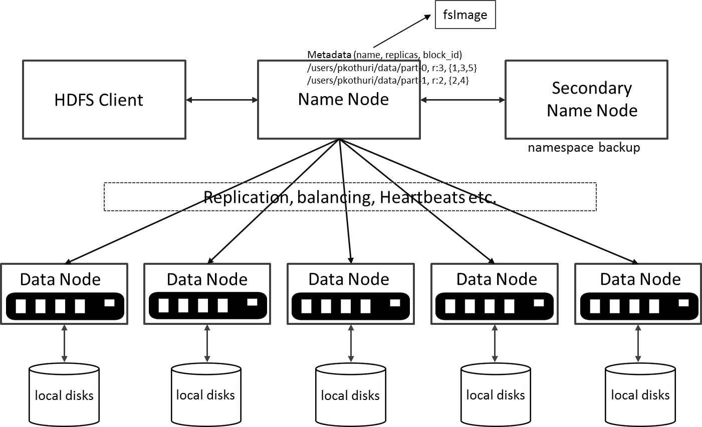
HDFS Architecture

Slide 5
Unique features of HDFS
HDFS also has a bunch of unique features that make it ideal for distributed systems:
Failure tolerant - data is duplicated across multiple DataNodes to protect against machine failures. The default is a replication factor of 3 (every block is stored on three machines).
Scalability - data transfers happen directly with the DataNodes so your read/write capacity scales fairly well with the number of DataNodes
Space - need more disk space? Just add more DataNodes and re-balance
Industry standard - Other distributed applications are built on top of HDFS (HBase, Map-Reduce)
HDFS is designed to process large data sets with write-once-read-many semantics, it is not for low latency access

Slide 6
HDFS – Data Organization
Each file written into HDFS is split into data blocks
Each block is stored on one or more nodes
Each copy of the block is called replica
Block placement policy
First replica is placed on the local node
Second replica is placed in a different rack
Third replica is placed in the same rack as the second replica
Notes:
NameNode and DataNode each run an internal web server in order to display basic information about the current status of the cluster

Slide 7
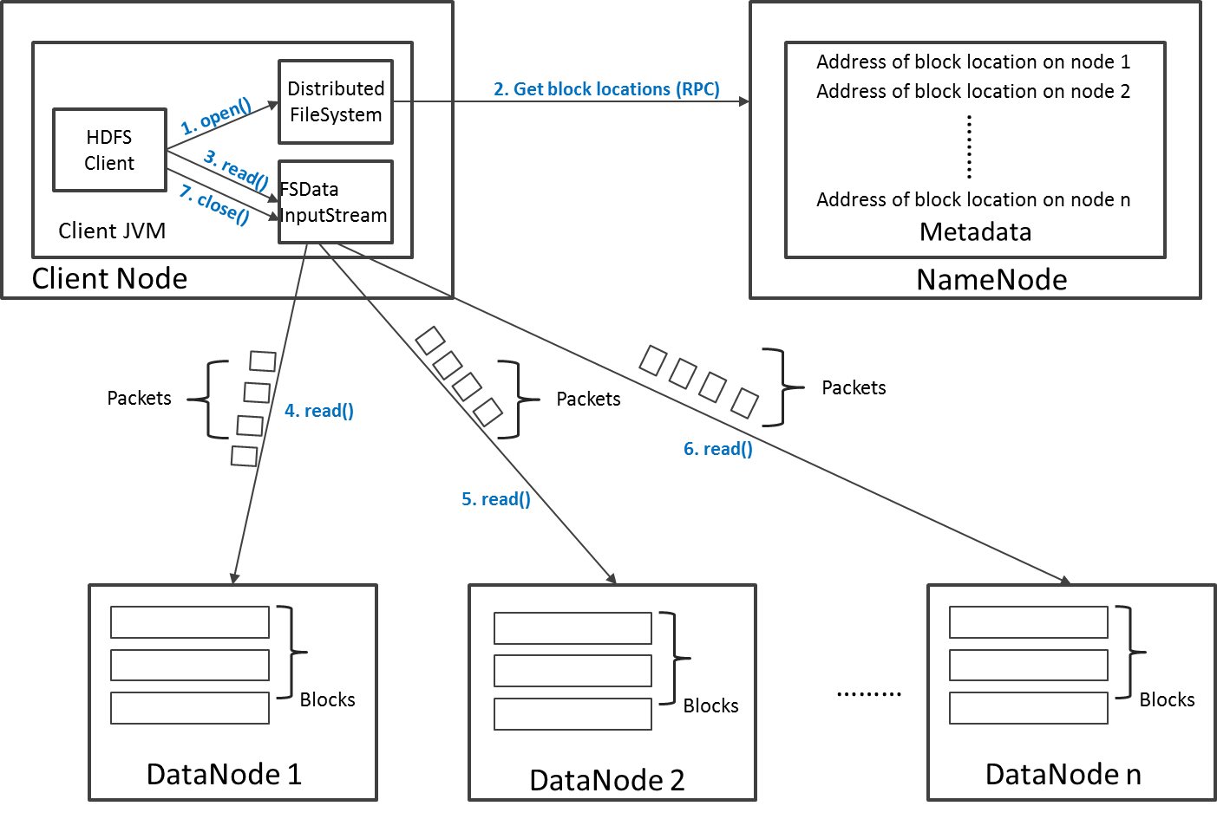
Read Operation in HDFS

Slide 8
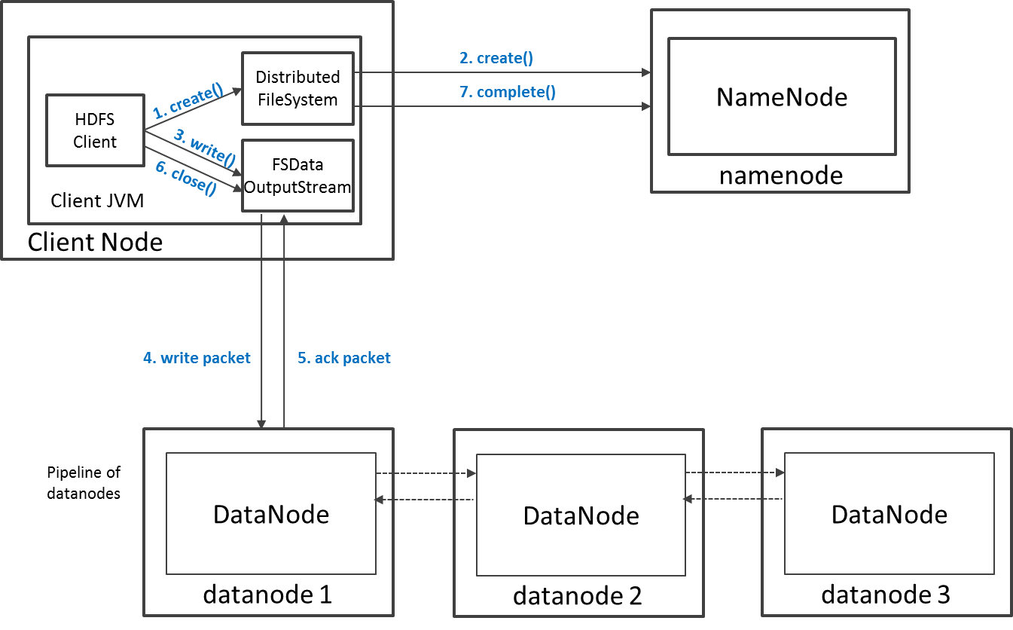
Write Operation in HDFS

Slide 9
HDFS Security
Authentication to Hadoop
Simple – insecure way of using OS username to determine hadoop identity
Kerberos – authentication using kerberos ticket
Set by hadoop.security.authentication=simple|kerberos
File and Directory permissions are same like in POSIX
read (r), write (w), and execute (x) permissions
also has an owner, group and mode
enabled by default (dfs.permissions.enabled=true)
ACLs are used for implemention permissions that differ from natural hierarchy of users and groups
enabled by dfs.namenode.acls.enabled=true
Notes:
NameNode and DataNode each run an internal web server in order to display basic information about the current status of the cluster

Slide 10
HDFS Configuration
HDFS Defaults
Block Size – 64 MB
Replication Factor – 3
Web UI Port – 50070
HDFS conf file - /etc/hadoop/conf/hdfs-site.xml
<property>
<name>dfs.namenode.name.dir</name>
<value>file:///data1/cloudera/dfs/nn,file:///data2/cloudera/dfs/nn</value>
</property>
<property>
<name>dfs.blocksize</name>
<value>268435456</value>
</property>
<property>
<name>dfs.replication</name>
<value>3</value>
</property>
<property>
<name>dfs.namenode.http-address</name>
<value>itracXXX.cern.ch:50070</value>
</property>
Notes:
NameNode and DataNode each run an internal web server in order to display basic information about the current status of the cluster

Slide 11
Interfaces to HDFS
Java API (DistributedFileSystem)
C wrapper (libhdfs)
HTTP protocol
WebDAV protocol
Shell Commands
However the command line is one of the simplest and most familiar

Slide 12
HDFS – Shell Commands
There are two types of shell commands
User Commands
hdfs dfs – runs filesystem commands on the HDFS
hdfs fsck – runs a HDFS filesystem checking command
Administration Commands
hdfs dfsadmin – runs HDFS administration commands
Notes:
NameNode and DataNode each run an internal web server in order to display basic information about the current status of the cluster

Slide 13
HDFS – User Commands (dfs)
List directory contents
Display the disk space used by files
hdfs dfs –ls
hdfs dfs -ls /
hdfs dfs -ls -R /var
hdfs dfs -du -h /
hdfs dfs -du /hbase/data/hbase/namespace/
hdfs dfs -du -h /hbase/data/hbase/namespace/
hdfs dfs -du -s /hbase/data/hbase/namespace/
Notes:
NameNode and DataNode each run an internal web server in order to display basic information about the current status of the cluster

Slide 14
HDFS – User Commands (dfs)
Copy data to HDFS
Copy the file back to local filesystem
hdfs dfs -mkdir tdata
hdfs dfs -ls
hdfs dfs -copyFromLocal tutorials/data/geneva.csv tdata
hdfs dfs -ls –R
cd tutorials/data/
hdfs dfs –copyToLocal tdata/geneva.csv geneva.csv.hdfs
md5sum geneva.csv geneva.csv.hdfs

Slide 15
HDFS – User Commands (acls)
List acl for a file
List the file statistics – (%r – replication factor)
Write to hdfs reading from stdin
hdfs dfs -getfacl tdata/geneva.csv
hdfs dfs -stat "%r" tdata/geneva.csv
echo "blah blah blah" | hdfs dfs -put - tdataset/tfile.txt
hdfs dfs -ls –R
hdfs dfs -cat tdataset/tfile.txt

Slide 16
HDFS – User Commands (fsck)
Removing a file
List the blocks of a file and their locations
Print missing blocks and the files they belong to
hdfs dfs -rm tdataset/tfile.txt
hdfs dfs -ls –R
hdfs fsck /user/cloudera/tdata/geneva.csv -files -blocks –locations
hdfs fsck / -list-corruptfileblocks

Slide 17
HDFS – Adminstration Commands
Comprehensive status report of HDFS cluster
Prints a tree of racks and their nodes
Get the information for a given datanode (like ping)
hdfs dfsadmin –report
hdfs dfsadmin –printTopology
hdfs dfsadmin -getDatanodeInfo localhost:50020
Notes:
NameNode and DataNode each run an internal web server in order to display basic information about the current status of the cluster

Slide 18
HDFS – Advanced Commands
Get a list of namenodes in the Hadoop cluster
Dump the NameNode fsimage to XML file
The general command line syntax is
hdfs command [genericOptions] [commandOptions]
hdfs getconf –namenodes
cd /var/lib/hadoop-hdfs/cache/hdfs/dfs/name/current
hdfs oiv -i fsimage_0000000000000003388 -o /tmp/fsimage.xml -p XML
Notes:
NameNode and DataNode each run an internal web server in order to display basic information about the current status of the cluster

Slide 19
Other Interfaces to HDFS
HTTP Interface
MountableHDFS – FUSE
Once mounted all operations on HDFS can be performed using standard Unix utilities such as 'ls', 'cd', 'cp', 'mkdir', 'find', 'grep',
http://quickstart.cloudera:50070
mkdir /home/cloudera/hdfs
sudo hadoop-fuse-dfs dfs://quickstart.cloudera:8020 /home/cloudera/hdfs

